Slide 1
Module1 & Module 2

Slide 2
Data are everywhere.
Most of the projects in several companies every day generate 2.5 quintillion bytes of data.
Not be interpreted in an absolute sense.
The strong need for analytical skills and resources.
As the data piles up, managing and analyzing these data resources in the most optimal way become critical success factors in creating competitive advantage and strategic leverage.

Slide 3
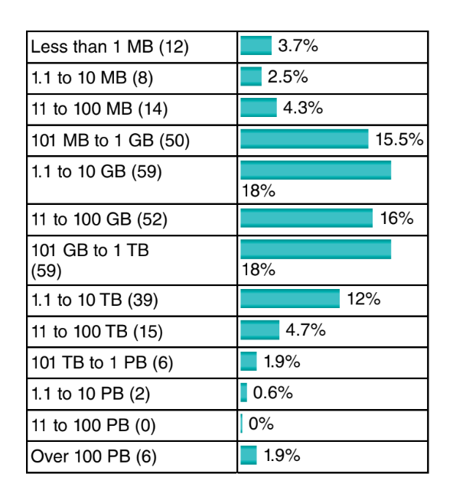
Context of the Poll
Number of Respondents
Categories and Numbers
Median Size of Data
Comparison with Previous Year
Regional Breakdown

Slide 4
Catalogue in the Mail: marketing efforts and increase the likelihood of sales.
Behavioral Scoring Model by Financial Institution:predictive analytics help the bank manage risks and make informed decisions regarding loan provisioning.
Churn Prediction by Telephone Service Provider:customer retention strategies and service improvements.
Social Media Advertising on Facebook: tailor advertisements to your interests
Supermarket Loyalty Card and Market Basket Analysis:supermarket make decisions on product bundling, offers
Credit Card Fraud Detection: prevent fraudulent transactions, protecting both consumers and financial institutions.

Slide 5
Basic Nomenclature:
In order to start doing analytics, some basic vocabulary needs to be defined. The basic unit of analysis.
For Example : Customers can be considered basic unit in several cases like credit scoring exercise,parents can buy goods for their kids, such that there is a clear distinction between the payer and the end user,In a banking setting, a customer can be primary account owner, secondary account owner, main debtor of the credit, codebtor, guarantor, and so on.
In case of predictive analytics, the target variable needs to be appropriately defined.When the customer considered to be a churner or not, a fraudster or not, a responder or not.

Slide 6
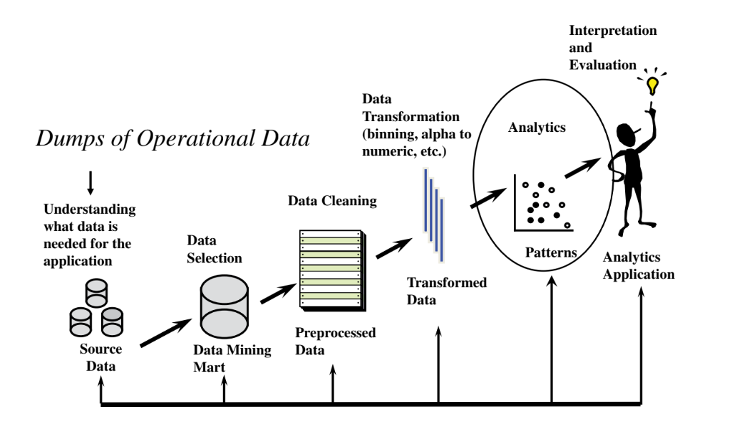
The Analytics Process Model

Slide 7
Data Collection,Sampling, and Preprocessing
Data are key ingredients for any analytical exercise.
It is important to thoroughly consider and list all data sources that are of potential interest before starting the analysis.
TYPES OF DATA SOURCES:
Data can originate from a variety of different sources.
1.Transactions
2.Qualitative, expert‐based data.
3.Publicly available data can be included in the analytical exercise.

Slide 8
1.Transactions
Transactional data are fundamental sources of information in data analysis and are typically structured, detailed records that capture specific actions or events.
Point of Sale Transactions
Online Orders:
Inventory Management Transactions
Customer Service Interactions
Characteristics of Transactional Data: Structured,Detailed,Low-level,
Stored in OLTP Databases.

Slide 9
2. Expertise in Analytics
An expert in analytics is someone who possesses significant subject matter knowledge and experience within a specific domain, such as finance or marketing.
Imagine a credit portfolio manager at a financial institution who oversees the management of loans and credit risk.
Data Evaluation and Expert Input
Modeling and Validation
Model Interpretation and Decision Making

Slide 10
Sampling
The aim of sampling is to take a subset of past customer data and use that to build an analytical model.
Computational Efficiency
Representativeness
Time Window:
Lots of Data
Recent Data

Slide 11
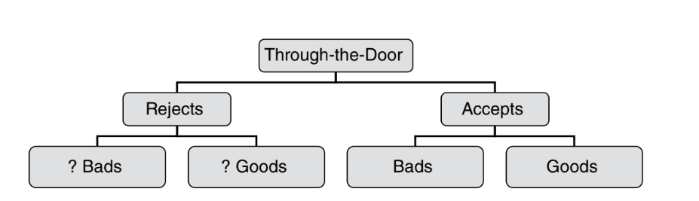
Sampling Bias
Example - Credit Scoring: For instance, when building a credit scorecard for Loan applications, historical data may be biased because rejected applicants (who didn't receive credit) are not included, leading to an incomplete picture.
Reject Inference
Withdrawals

Slide 12
Stratified Sampling
Stratified sampling involves dividing the dataset into pre-defined strata based on certain criteria (e.g., Fraudulent vs. Legitimate).
Illustration : when data is skewed, such as in fraud detection where most cases are non-events (Legitimate), stratified sampling can be employed.
Two classes : Fraud and Legitimate

Slide 13
TYPES OF DATA ELEMENTS
Continuous: income ( Quantitative)
Categorical : (Qualitative)
■ Nominal: marital status, profession, purpose of loan.
■ Ordinal: Include credit rating(Good,fair,Excellent); age(young, middle aged, and old),Feedback(Strongly agree,agree…..).
■ Binary: gender, employment status.
Data Type Selection
Data Handling
Data Collection
For example, if marital status were to be incorrectly specified as a continuous data element, then the software would calculate its mean, standard deviation, and so on, which is obviously meaningless.

Slide 14
VISUAL DATA EXPLORATION AND EXPLORATORY STATISTICAL ANALYSIS
Visual data exploration is a crucial preliminary step in data analysis that involves using graphical representations to gain initial insights into the dataset.
Initial Insights
Pattern Recognition
Data Validation
Types of Visual Tools Used:Pie Charts,Bar Charts,Histograms,Scatter Plots

Slide 15
Next Steps after Visual Analysis:
Analysts typically compute statistical measures such as averages, standard deviations, minimum, maximum, percentiles, and confidence intervals.
These measures help quantify the characteristics of the data and compare distributions between different groups or classes(Fraud or legitimate)(good payer or bad)

Slide 16
Missing values & Handling Missing Values
Missing values in datasets can arise due to various reasons
1.Non applicable Information
2.Undisclosed Information
3.Errors During Data Handling
Handling missing values is essential to ensure accurate and reliable analysis.
1.Imputation: Mean/Median/Regression Models
2.Deletion
3.Keeping Missing as a Separate Category:a customer not disclosing income due to being unemployed

Slide 17
OUTLIER DETECTION AND TREATMENT
Outliers are observations in a dataset that are significantly different from the majority of other data points. They can be classified into two main types:
1.Valid Observations:the salary of a CEO being $1 million per year
2.Invalid Observations:someone's age is recorded as 300 years
Types of Outliers:
1.Univariate Outliers:extremely high or low value in income
2.Multivariate Outliers: someone might have both an exceptionally high income and a very young

Slide 18
Detection of Outliers
1 Histograms: Visualizing the distribution of data to identify unusual patterns or tails in the data distribution.
2. Box Plots (Box-and-Whisker Plots): Showing the distribution of data in quartiles, with outliers indicated as points beyond a certain distance from the quartiles (typically defined as 1.5 times the Interquartile Range, IQR).
3. Z-Scores: Calculating how many standard deviations an observation is away from the mean.
Example: Values with a z-score greater than 3 (or less than -3) are often considered outliers.

Slide 19
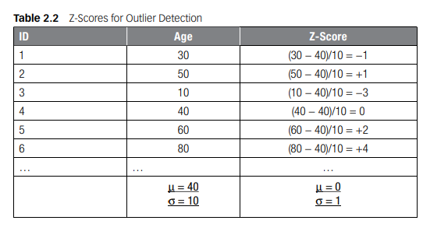

Slide 20
STANDARDIZING DATA
Standardizing data is a crucial preprocessing step in data analysis, particularly when dealing with variables that have different scales or units.
Data standardization helps eliminate redundancies, errors and inconsistencies, resulting in higher data quality. By ensuring data is accurate, clean and consistent, organizations can have confidence in their decision-making process
1. Min/Max Standardization (Normalization):Min/max standardization, also known as normalization, scales the values of a numeric variable to a specific range, typically between 0 and 1.
Xnew​=X−Xmin/ ​Xmax−Xmin​​
where:
X is the original value of the variable,
Xmin​ is the minimum value of the variable,
Xmax​ is the maximum value of the variable.
If income ranges from $0 to $1,000,000, after min/max standardization, the income values will be scaled proportionally between 0 and 1.

Slide 21
2. Z-Score Standardization : Z-score standardization (or normalization) transforms variables to have a mean of 0 and a standard deviation of 1. The formula for z-score standardization is:
Xnew​= X−μ ​/ σ
where:
X is the original value of the variable,
μ is the mean of the variable,
σ is the standard deviation of the variable.
3. Decimal Scaling : Decimal scaling involves dividing the variable by a power of 10 such that the maximum absolute value of the resulting variable is between 0 and 1. The formula for decimal scaling is:
Xnew​=X​ / 10^{n}
where:
X is the original value of the variable,
n is the number of digits of the maximum absolute value of X.

Slide 22
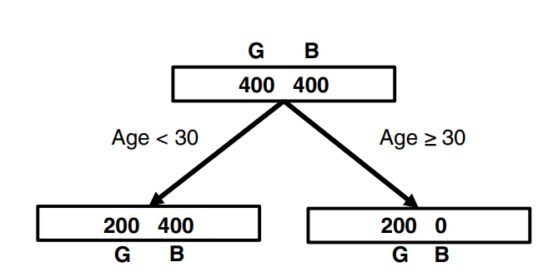
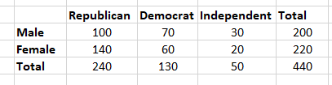
Problems:
Using the runs scored by a cricket team in 12 league matches 100, 120, 110, 150, 110, 140, 130, 170, 120, 220, 140, 110, construct a box plot to visually identify and represent any outliers in the data.
Calculate the Z-scores for the following exam scores: [30, 50, 10, 40, 60, 80], given that the class average score (μ) is 40 and the standard deviation (SD) is 10.
Calculate the entropy for the top node, left node, and right node, and determine the information gain.
If gender has anything to do with political party preference. You poll 440 voters in a simple random sample to find out which political party they prefer. The results of the survey are shown in the table below:

Slide 23
The data provided pertains to different categories of residential status and their associated outcomes categorized as "Good" and "Bad". Here’s a breakdown of the data and the approach to coarse classification:
The frequencies for each category under the "Good" and "Bad" outcomes are provided:
Objective:
The objective is to classify the residential status variable into three categories using chi-squared analysis. Two options are considered:
Option 1: Owner, Renters, Others
Option 2: Owner, With Parents, Others
Chi-Squared Analysis
Chi-squared analysis helps determine if there is a significant association between categorical variables. Here, it’s used to evaluate how well the observed frequencies (from the data) match the expected frequencies (if the categories were independent).
Attribute | Owner | Rent Unfurnished | Rent Furnished | With Parents | Other | No Answer | Total
Good | 6,000 | 1,600 | 350 | 950 | 90 | 10 | 9,000
Bad | 300 | 400 | 140 | 100 | 50 | 10 | 1,000

Slide 24
CATEGORIZATION
Categorization = coarse classification, classing, grouping, binning, etc.
Categorization refers to the process of grouping data into discrete categories or bins based on certain criteria.
Example: Rainfall Prediction Dataset
Dataset Description: Imagine we have a dataset that includes information about rainfall in different regions over several years. Each record in the dataset might include:
Region: The geographical area where the rainfall was measured.
Month: The month in which the rainfall data was recorded.
Rainfall Amount: The amount of rainfall measured in millimeters (mm).
Temperature: The temperature recorded during the rainfall event.

Slide 25
Categorization Process
Grouping by Rainfall Amount:
Low Rainfall: 0-50 mm
Moderate Rainfall: 51-100 mm
High Rainfall: >100 mm
Simplify the analysis
Easier to interpret patterns and trends in the data.
2. Grouping by Month:
Spring: March, April, May
Summer: June, July, August
Autumn: September, October, November
Winter: December, January, February
Help identify seasonal patterns in rainfall.
Analyze how rainfall varies across different seasons.

Slide 26
3. Grouping by Temperature Range:
Cool: 0-10°C
Moderate: 11-25°C
Warm: 26-35°C
Hot: >35°C
Understand how temperature influences rainfall patterns and vice versa.
Purposes of Categorization:
Simplifying Analysis
Reducing Complexity
Preparing for Models

Slide 27
For categorical variables, it is needed to reduce the number of categories:
Categorical variables : qualitative data and can take on a finite number of distinct values or categories. For example, "Gender" (Male, Female), "Education Level" (High School, College, Graduate), or "Country" (USA, Canada, UK).
Categorical variables can have a large number of distinct categories. For instance, a variable like "City" could have hundreds or thousands of unique values if each city is considered separately. This can complicate statistical analysis and modeling because each category may not have enough data points for reliable estimation or inference.
To address this complexity, reducing the number of categories by grouping similar values together can be beneficial. This process, known as categorization or grouping, simplifies the dataset by consolidating similar categories into broader groups.
By reducing the number of categories, the dataset becomes more manageable for analysis.

Slide 28
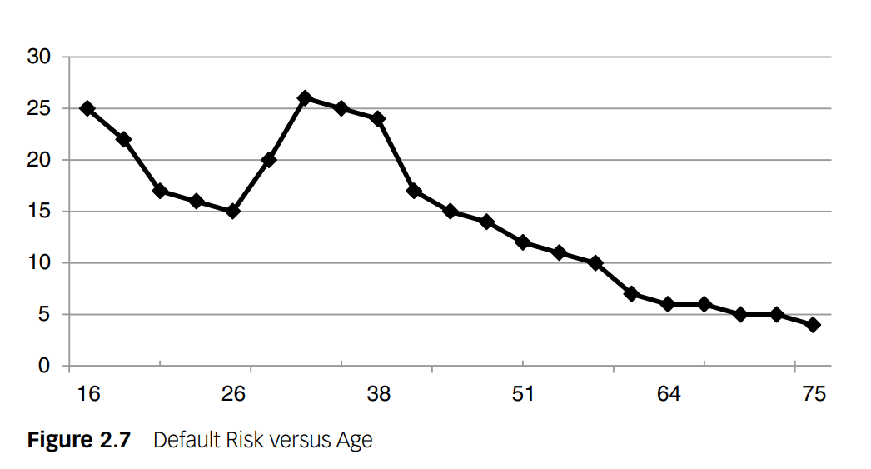
Relation between risk and age are not linear or monotonous.
Nonlinear models such as neural networks or support vector machines can capture complex such relationships. These models are flexible and can fit intricate patterns in data without assuming linearity.
In contrast to nonlinear models, traditional regression models (like linear regression) assume a linear relationship between the predictor (age) and the outcome (risk).
By categorizing the variable into ranges, part of the nonmonotonicity can be taken into account in the regression. Hence, categorization of continuous variables can be useful to model nonlinear effects into linear models.

Slide 29
Various methods can be used to do categorization
Equal interval binning
Equal frequency binning.

Slide 30
Equal interval binning
Equal interval binning involves dividing the range of continuous values into equal-sized intervals or bins. This method is straightforward and ensures that each interval has the same width.
Example: Age Distribution
Suppose we have a dataset of individuals with their ages recorded in years. We want to categorize age into 5 equal intervals using equal interval binning:
Data:
Ages: 18, 22, 25, 30, 35, 40, 45, 50, 55, 60
Equal Interval Bins:
Interval 1: 18-27 years
Interval 2: 28-37 years
Interval 3: 38-47 years
Interval 4: 48-57 years
Interval 5: 58-67 years

Slide 31
Equal frequency binning
Divides the data set into bins that all have the same number of samples.
Input: [5, 10, 11, 13, 15, 35, 50, 55, 72, 92, 204, 215]
Output: [5, 10, 11, 13] [15, 35, 50, 55] [72, 92, 204, 215]

Slide 32
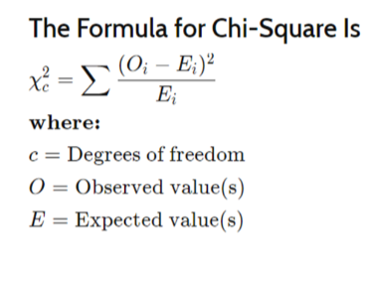
Chi-squared analysis is another method to do categorization.
A chi-square (χ2) statistic is a test that measures how a model compares to actual observed data.
A chi-square test is used to help determine if observed results are in line with expected results, and to rule out that observations are due to chance.
A chi-square test is appropriate for this when the data being analysed is from a random sample,and when the variable in question is a categorical variable.
χ2 provides a way to test how well a sample of data matches the (known or assumed) characteristics of the larger population that the sample is intended to represent. This is known as goodness of fit.

Slide 33
Variable Selection
Variable selection is a crucial step in analytical modeling, especially when dealing with datasets that contain numerous variables.
The goal is to identify and retain only those variables that significantly contribute to predicting the target variable of interest.
In many modeling exercises, datasets may contain a large number of variables, but not all of them are relevant or useful for predicting the outcome (target variable). Including irrelevant variables can lead to overfitting and reduced model performance on new data.
Filters are a type of variable selection method that operate by evaluating the individual relationship between each predictor variable and the target variable.
Mechanism of Filters:
Univariate Correlation Measurement: Filters assess the strength of association between each predictor variable and the target variable independently. Common measures used for this purpose include:
Pearson's correlation coefficient: Measures linear correlation between numeric variables.
Chi-squared test: Assesses association between categorical variables and the target.
Information gain: Measures the reduction in entropy or uncertainty about the target variable given the predictor variable.

Slide 34
TARGET DEFINITION
Understanding the target variable is crucial in any analytical or modeling process because it defines what you are trying to predict or understand.
Customer Attrition (Churn)
Active Churn: Occurs when a customer intentionally terminates their relationship with a company, such as cancelling a contract with a postpaid telecom provider.
Passive Churn: Happens when a customer reduces their engagement with a company without formally terminating it, like decreasing purchase frequency at a supermarket.
Forced Churn: Initiates when a company discontinues its relationship with a customer due to reasons like fraud.
Expected Churn: Occurs when a customer no longer needs a product or service, such as buying baby products.

Slide 35
Fraud Detection:
Identifying fraudulent transactions or claims is challenging, typically requiring expert judgment or suspicion based on legal criteria.
Response Modeling:
Gross Response: Represents customers who make a purchase after receiving a marketing message.
Net Response: Focuses on customers who purchase specifically because of the marketing message

Slide 36
Customer Lifetime Value (CLV) is a metric that represents the total revenue a business expects to earn from a customer over the entirety of their relationship. It takes into account both direct and indirect revenue generated from the customer, deducting the costs associated with serving that customer, and considers the probability of the customer remaining active over a specified time horizon.
Continuous Target: Represents the total value a customer is expected to bring over their entire relationship with a business, factoring in revenue, costs, survival probability, and discounting over a specified time horizon.

Slide 37
Importance of Defining the Target
Clarity: Ensures everyone understands what the analysis aims to predict or understand.
Relevance: Focuses efforts on variables and models that directly impact the target variable.
Consistency: Allows for meaningful comparisons and evaluations over time.
Before proceeding with modeling, it's crucial to validate the chosen target definition for robustness and stability.

Slide 38
Linear Regression
Linear regression is a fundamental statistical method used for modeling the relationship between a dependent variable (often denoted as Y) and one or more independent variables (denoted as X1,X2,…, Xp​).
Dependent Variables = target or response variable
Independent variables = predictors or features
It assumes a linear relationship between the predictors and the response variable.

Slide 39

Model Representation
The linear regression model can be represented as:
Y is the dependent variable (target or response variable).
X1,X2,…,Xp ​ are independent variables (predictors or features).
β0,β1,…,βp​ are coefficients that represent the relationship between the independent variables and the dependent variable.
ϵ is the error term which represents the variability in Y that cannot be explained by the linear relationship with X.

Slide 40
Parameter Estimation
Linear regression estimates the coefficients β0,β1,…,βp​ using methods such as Ordinary Least Squares (OLS).
OLS finds the values of β that minimize the sum of squared differences between the observed values of Y and the values predicted by the linear model.

Slide 41
Interpreting Coefficients
β0​ (intercept): The value of Y when all X variables are zero.
βj (slope coefficients for Xj): The change in Y for a one-unit change in Xj​, holding other variables constant.

Slide 42
Evaluation
R-squared ( R2 ): Measures the proportion of the variance in the dependent variable that is predictable from the independent variables.
Standard Error: Measures the average distance between the data points and the fitted line in the model.
P-values and Confidence Intervals: Indicate the statistical significance of the coefficients βj, helping determine which predictors are important in explaining Y.

Slide 43
LOGISTIC REGRESSION
Linear Regression for Classification Issues:
Error Distribution: Linear regression assumes that the errors (residuals) are normally distributed. In classification tasks, especially when dealing with binary outcomes (e.g., yes/no, 0/1), the response variable Y typically follows a Bernoulli distribution (or binomial distribution for multi-class problems). This means the response variable Y can only take on values of 0 or 1, which does not align with the continuous nature assumed by linear regression.
Interpretation of Predictions :Linear regression predicts continuous values, which are not naturally interpretable as probabilities, particularly because these values can fall outside the [0, 1] range. In classification, we often want predictions that can be directly interpreted as probabilities of belonging to a class.

Slide 44
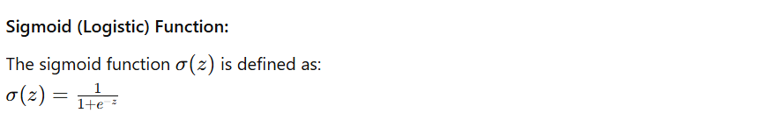
Logistic Regression Transformation:
Logistic regression is often used in classification tasks.
Logistic regression transforms the output of a linear regression model using a sigmoid function (also known as the logistic function), which ensures that the predicted values are bounded between 0 and 1, suitable for interpreting as probabilities.
Where:
z is the linear combination of predictors and coefficients from the linear regression model.

Slide 45


Example :
Linear Regression Prediction : $\hat{Y}$= $β_{0}+β_{1}∗Age$
$\hat{Y}$=0.8 ( which is neither 0 nor 1) (not tell us about probability )
In contrast, logistic regression transforms the output of the linear model using the sigmoid function σ(z):
if P(Purchased=1|Age=30)=0.8 (80% probability that customer aged 30 will purchase the product)

Slide 46

Logistic Regression Model
The logistic regression model transforms the linear regression prediction z into a probability:
P(Y=1∣X) using the sigmoid function:
P(Y=1∣age, income, gender)=$β_{0}+β_{1}$​age+$β_{2}$​income+$β_{3}$​gender)
Here:
$β_{0},β_{1}$, $β_{2}$, $β_{3}$are the coefficients estimated by logistic regression.
age, income, gender are the predictor variables.

Slide 47
Advantages of Logistic Regression
Probability Interpretation
Bounded Outputs
Logistic regression addresses the shortcomings of using linear regression for classification by transforming the linear prediction into a probability using the sigmoid function.
This transformation ensures that predictions are bounded between 0 and 1, allowing for straightforward interpretation as probabilities, which is essential in classification tasks where the goal is often to predict binary outcomes.

Slide 48
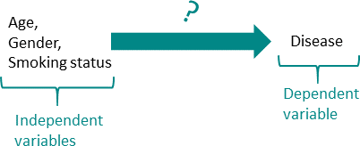
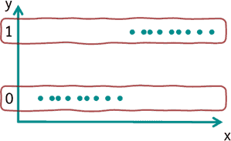
In medicine, for example, a frequent application is to find out which variables have an influence on a disease. In this case, 0 could stand for not diseased and 1 for diseased. Subsequently, the influence of age, gender and smoking status (smoker or not) on this particular disease could be examined.
In the basic form of logistic regression, dichotomous variables (0 or 1) can be predicted. For this purpose, the probability of the occurrence of value 1 (=characteristic present) is estimated.

Slide 49
In linear regression, the independent variables (e.g., age and gender) are used to estimate the specific value of the dependent variable (e.g., body weight).
In logistic regression, on the other hand, the dependent variable is dichotomous (0 or 1) and the probability that expression 1 occurs is estimated.
Example: How likely is it that the disease is present if the person under consideration has a certain age, gender and smoking status.

Slide 50
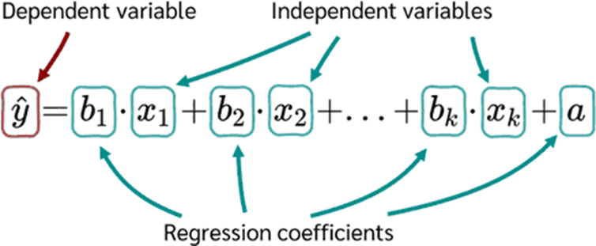
To build a logistic regression model, the linear regression equation is used as the starting point.

Slide 51
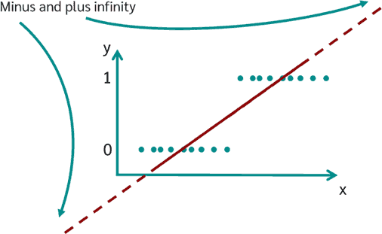
If a linear regression were simply calculated for solving a logistic regression, the following result would appear graphically:
Values between plus and minus infinity can now occur.
The goal of logistic regression, however, is to estimate the probability of occurrence and not the value of the variable itself. Therefore, the this equation must still be transformed.

Slide 52
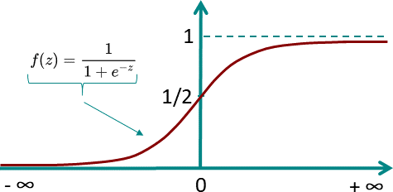
Logistic Function/Sigmoid Function
The logistic model is based on the logical function. The special thing about the logistic function is that for values between minus and plus infinity, it always assumes only values between 0 and 1.
So the logistic function is perfect to describe the probability P(y=1).

Slide 53
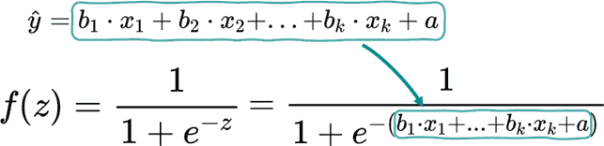
If the logistic function is now applied to the previous regression equation the result is:

Slide 54
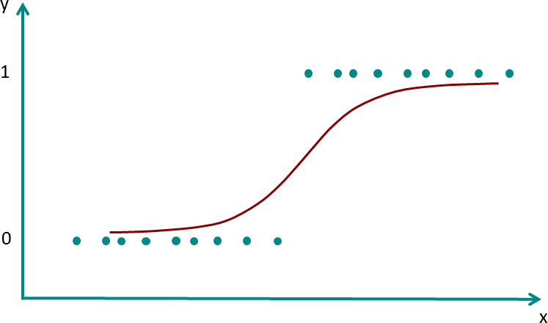
This now ensures that no matter in which range the x values are located, only values between 0 and 1 will come out.
The new graph now looks like this:

Slide 55


The probability that for given values of the independent variable the dichotomous dependent variable y is 0 or 1 is given by:
To calculate the probability of a person being sick or not using the logistic regression for the example the model parameters b1, b2, b3 and a must first be determined. Once these have been determined, the equation for the example above is:

Slide 56
Maximum Likelihood Method
To determine the model parameters for the logistic regression equation, the Maximum Likelihood Method is applied.
The maximum likelihood method is one of several methods used in statistics to estimate the parameters of a mathematical model.
Another well-known estimator is the least squares method, which is used in linear regression.

Slide 57

Linear Decision Boundary :
Logistic regression models the log odds (logit) of the binary outcome as a linear combination of the input variables:
Odds Ratio Interpretation:
To interpret the logistic regression coefficients:
Suppose a variable Xi increases by one unit while keeping all other variables constant. The change in the logit can be represented as: New logit=Old logit+βi​
The corresponding change in the odds is:
Here, eβi is the odds ratio, which represents how much the odds of the outcome increase (or decrease) when Xi​ increases by 1 unit:
If βi>0, then eβi>1: The odds and probability of the outcome increase with Xi.
If βi<0, then eβi<1: The odds and probability of the outcome decrease with Xi​.

Slide 58
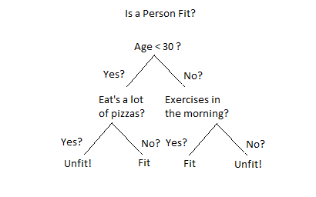
Decision Tree
Decision trees are recursive partitioning algorithms (RPAs) that come up with a tree-like structure representing patterns in an underlying data set. They are popular in machine learning for both classification and regression tasks.
The decision tree consists of several components:
Root Node: The top node representing the
initial testing condition.
Internal Nodes: Nodes representing testing
conditions with outcomes leading to more nodes.
Leaf Nodes: Terminal nodes that provide the
final classification or prediction.

Slide 59
Key Decisions in Building a Decision Tree
Splitting Decision: Determines which variable to split and at what value (e.g., age < 30). This involves minimizing impurity or chaos in the dataset.
Stopping Decision: Determines when to stop growing the tree to avoid overfitting. Overfitting occurs when the tree becomes too specific to the training data, leading to poor generalization to new data. To prevent this, the data is split into a training set and a validation set. The tree growth is stopped based on performance metrics like misclassification error or other criteria.
Assignment Decision: Determines what class or value to assign to a leaf node. e.g., good or bad customer.

Slide 60
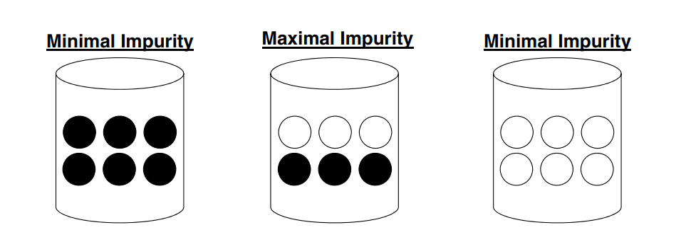


The three data sets below each of which contains good (unfilled circles) and bad (filled circles) customers.
Decision trees will now aim at minimizing the impurity in the data.
In order to do so appropriately, one needs a measure to quantify impurity. There are various measures.
Entropy: E(S) =
Gini: Gini(S) =
Chi‐squared analysis

Slide 61
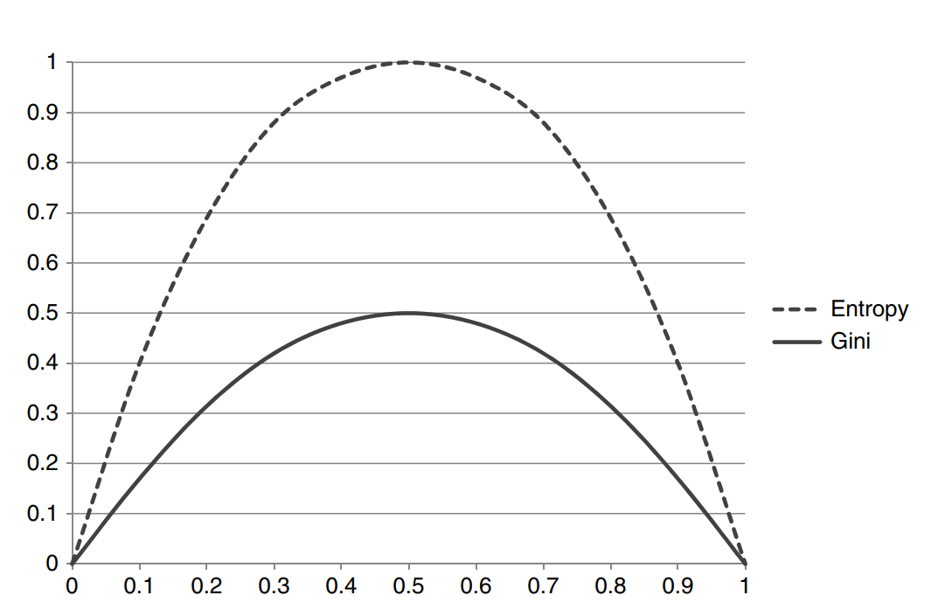
Which is more efficient among the methods then Gini Impurity and entropy in terms of computing power?
For entropy, it first increases up to 1 and then starts decreasing, but in the case of Gini impurity it only goes up to 0.5 and then it starts decreasing.
It requires less computational power. The range of Entropy lies in between 0 to 1 and the range of Gini Impurity lies between 0 to 0.5.

Slide 62
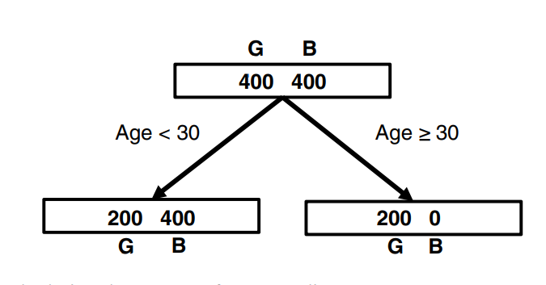
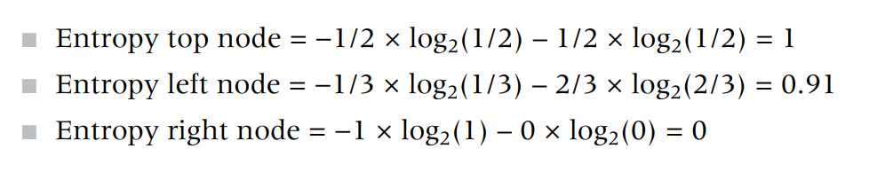
Calculating the Entropy for Age Split

Slide 63

The decision tree algorithm will now consider different candidate splits for its root node and adopt a greedy strategy by picking the one with the biggest gain.
Once the root node has been decided on, the procedure continues in a recursive way to continue tree growing.
When an attribute has an information gain of 0.32, it suggests that using this attribute reduces the uncertainty about the class labels in the data by 0.32 bits on average. Higher information gain indicates that the attribute is more important for classifying the data.

Slide 64
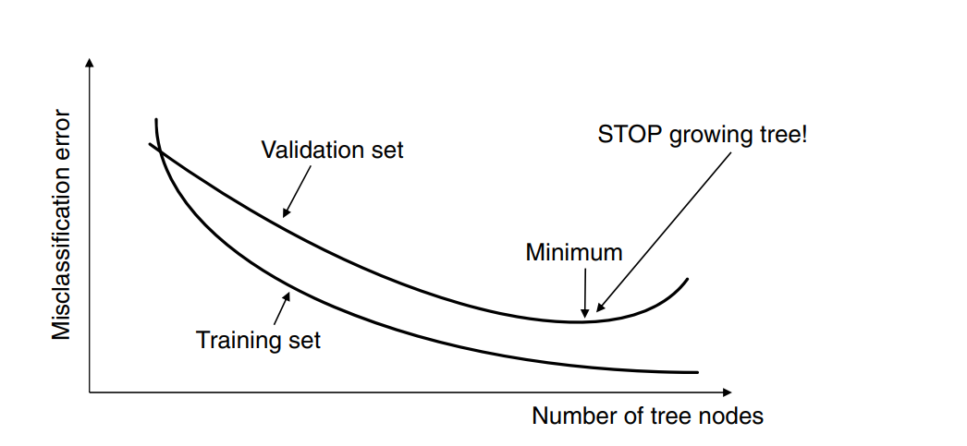
The error on the training sample keeps on decreasing as the splits become more and more specific toward it.
On the validation sample, the error will initially decrease, but at some point it will increase back again since the splits become too specific for the training sample as the tree starts to memorize it. Where the validation set curve reaches its minimum, the procedure should be stopped or overfitting will occur.

Slide 65
Every node had only two branches.
The advantage of this is that the testing condition can be implemented as a simple yes/no question.
Multiway splits allow for more than two branches and can provide trees that are wider but less deep.
In a read once decision tree, a particular attribute can be used only once in a certain tree path.
Every tree can also be represented as a rule set since every path from a root node to a leaf node makes up a simple if/then rule.
These rules can then be easily implemented in all kinds of software packages (e.g., Microsoft Excel).

Slide 66
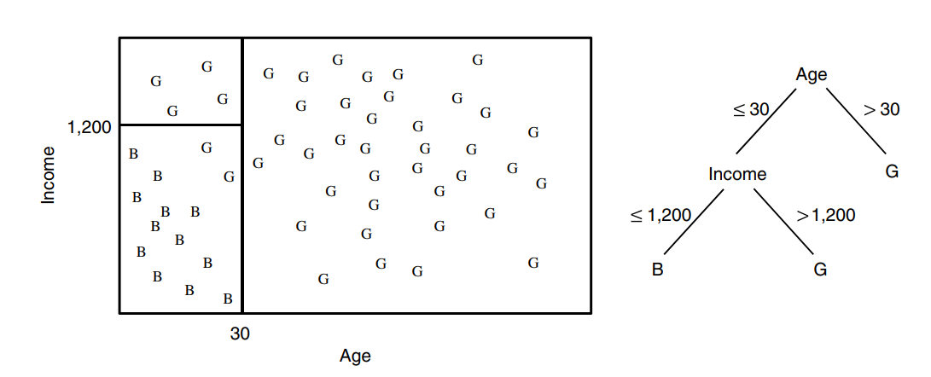
Decision trees essentially model decision boundaries orthogonal to the axes.
Decision Boundary of a Decision Tree

Slide 67
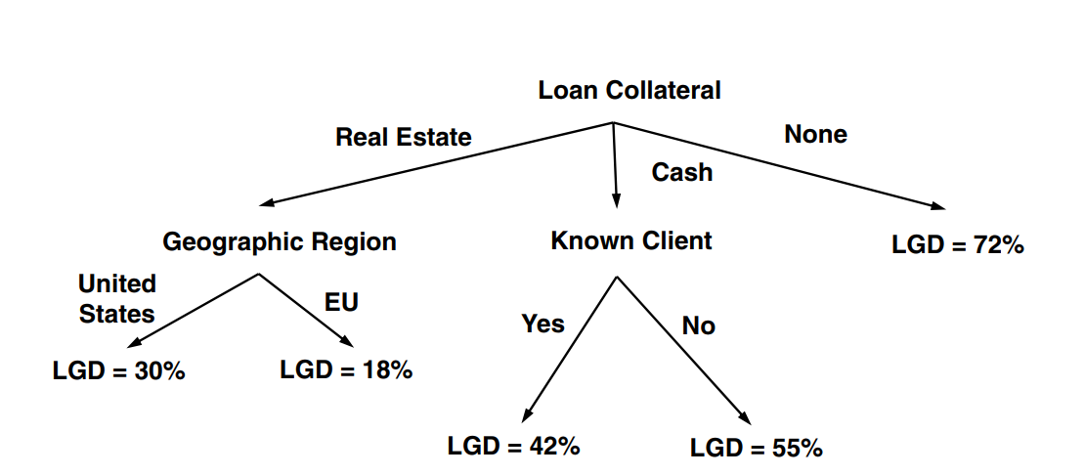
Decision trees can also be used for continuous targets. Example Regression Tree for Predicting LGD(Loss Given Default)

Slide 68
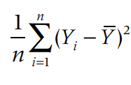
Different way to measure the impurity of the node in a decision tree are :
1. Mean Squared Error(MSE):
where
n = the number of observations in a leave node
Yi = the value of observation i
Y = the average of all values in the leaf node

Slide 69
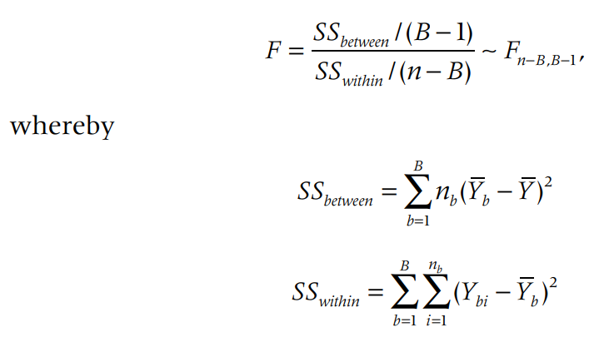
2. ANOVA(Analysis of Variance) Test and calculate F-Statistic:
B : the number of branches of the split
nb : the number of observations in branch b
Yb : the average in branch b
Ybi : the value of observation i in branch b
Y : the overall average
Good splits will then result in a high F value, or low corresponding p‐value.

Slide 70
Neural Network
Neural networks are computational models inspired by how the human brain works, but they are also closely related to existing statistical models.
Two Perspectives
Mathematical Representation Inspired by the Brain:
Neural networks can be seen as mathematical models that are loosely inspired by how the human brain works. This perspective focuses on mimicking the brain's neural structure to solve problems like pattern recognition, classification, and prediction.
Generalizations of Statistical Models:
Alternatively, neural networks can be viewed as extensions or generalizations of traditional statistical models. For instance, logistic regression can be understood as a special case of a neural network.

Slide 71
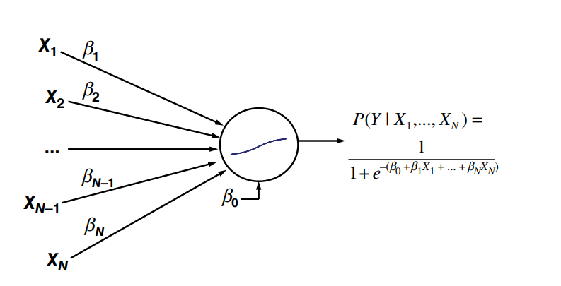
In a neural network view, this model can be seen as a network with a single neuron. The neuron performs two operations:
Weighted Sum: Computes a weighted sum of the inputs (including the bias term).
Nonlinear Transformation: Applies a logistic (sigmoid) function to the weighted sum. This transformation squashes the output to be between 0 and 1, which is ideal for binary classification.
Neural Network Representation of Logistic Regression
The processing element or neuron in the middle basically performs two operations:
It takes the inputs and multiplies them with the weights (including the intercept term β0, which is called the bias term in neural networks) then puts this into a nonlinear transformation function.
Logistic regression is a neural network with one neuron.

Slide 72
Multilayer Perceptron (MLP):
An MLP consists of multiple layers:
Input Layer: Receives the input features.
Hidden Layers: Intermediate layers that apply nonlinear transformations to the inputs.
Output Layer: Produces the final prediction.

Slide 73


Activation Functions:
Different activation functions determine how the neurons transform their inputs:
Logistic Function (Sigmoid): ranges from 0 to 1, often used for classification tasks.
Hyperbolic Tangent (tanh): ranges from -1 to 1, frequently used in hidden layers.
Linear Function: f(z)=z is used for regression tasks where the output is a continuous range.

Slide 74
Universal Approximation Theorem
One Hidden Layer:
Theoretically, a neural network with just one hidden layer can approximate any continuous function to a desired accuracy, given enough neurons. This property is known as the Universal Approximation Theorem.
More Hidden Layers:
For more complex patterns or functions, such as those involving discontinuities, additional hidden layers might be needed. However, in practice, many real-life datasets do not require this complexity.

Slide 75
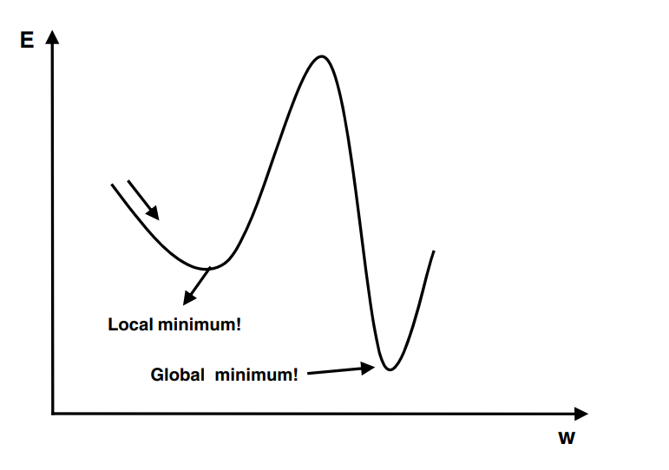
The point at which a function takes the minimum value is called global minima.
However, when the goal is to minimize the function and solved using optimization algorithms such as gradient descent, it may so happen that function may appear to have a minimum value at different points.
Those several points which appear to be minima but are not the point where the function actually takes the minimum value are called local minima.
Machine learning algorithms such as gradient descent algorithms may get stuck in local minima during the training of the models.

Slide 76
Error Function and Minima
Error Function (or Cost Function):
The error function measures how well the neural network’s predictions match the actual values. It’s a key part of the training process, and the goal is to minimize this function.
Local Minima vs. Global Minimum:
Global Minimum: The absolute lowest point of the error function. This is where the model performs the best, achieving the lowest possible error.
Local Minima: Points where the error function is lower than its immediate surroundings but not necessarily the lowest point overall. These are suboptimal solutions where the algorithm might get stuck.

Slide 77
Challenges with Local Minima
Multiple Local Minima:
The error function in neural networks can be complex with many local minima due to the non-linear nature of the network. This makes it challenging to find the global minimum.
Getting Stuck:
If the initial weights are poorly chosen, the optimization process might converge to a local minimum rather than the global minimum. This means the network might not perform as well as it could.

Slide 78
Strategies to Avoid Local Minima
Multiple Starting Points:
Trying Different Starting Weights: By initializing the network with different sets of starting weights and running the optimization multiple times, you increase the chances of finding a better (lower error) solution. This approach helps explore different regions of the error function landscape.
Best Intermediate Solution:
Early Stopping and Best Solution: Start the optimization with different weight initializations, and after some steps, save the best solution encountered so far. This way, you can continue training from the best intermediate solution rather than from a potentially worse initial setup.

Slide 79
Optimization Procedure
Iterative Process:
Epochs: An epoch refers to one complete pass through the entire training dataset. The optimization process involves running multiple epochs, adjusting weights based on the error function after each pass.
Stopping Criteria:
Error Function Progress: Continue the optimization until the error function no longer shows significant improvement, indicating that the network has converged to a minimum.
Weight Changes: Stop when the weights stop changing substantially, suggesting that further training might not yield better results.
Fixed Number of Steps: Alternatively, you can set a fixed number of optimization steps (epochs) to control the training duration, balancing between computational cost and model performance.

Slide 80
Neural networks are described as black boxes because their internal workings are complex and opaque. The relationships between inputs and outputs are not easily understandable due to the non-linear and multi-layered transformations involved. Two ways to open up the neural network black box are rule extraction and two‐stage models.
Decompositional rule extraction approaches decompose the network’s internal workings by inspecting weights and/or activation values. A typical five‐step approach here could be:
Train a neural network and prune it as much as possible in terms of connections.
Categorize the hidden unit activation values using clustering.
Extract rules that describe the network outputs in terms of the categorized hidden unit activation values.
Extract rules that describe the categorized hidden unit activation values in terms of the network inputs.
Merge the rules obtained in steps 3 and 4 to directly relate the inputs to the outputs.

Slide 81
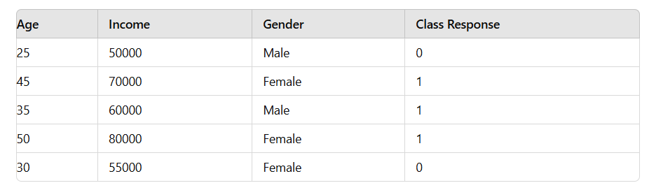
Example:

Slide 82
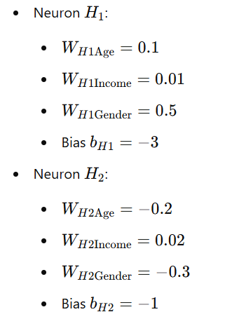
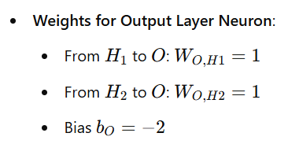
Steps in Decompositional Approach
1. Train a Neural Network and Prune Connections:
Let’s train a small neural network with:
Input Layer: 3 inputs (Age, Income, Gender encoded as 0 for Male and 1 for Female)
Hidden Layer: 2 neurons
Output Layer: 1 output neuron (Binary classification)
Assumed Weights and Biases:
Weights for Hidden Layer Neurons:

Slide 83
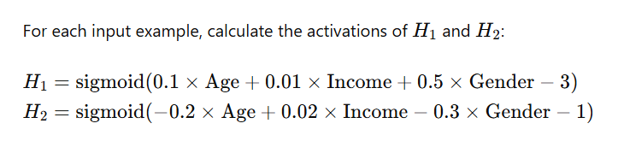

2. Categorize Hidden Unit Activation Values Using Clustering:
Hidden Layer Activation Calculation:
Perform clustering on the hidden unit activations to categorize them. For simplicity, let’s say we use k-means clustering to find 2 clusters for each hidden neuron.
Example Clustering Results:

Slide 84
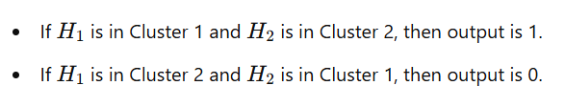
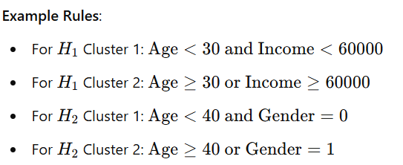
3. Extract Rules from Hidden Unit Activations to Network Outputs:
Determine the relationship between hidden unit activations and the output using rules:
Example Rules:
4. Extract Rules from Inputs to Categorized Hidden Unit Activations:
Determine the relationship between inputs and the categories of hidden unit activations:

Slide 85
5. Merge the Rules to Relate Inputs Directly to Outputs:
Combine the rules from steps 3 and 4 to directly relate the inputs to the outputs:
Example Combined Rules:
Rule 1 : If Age<30 and Income<60000 and Age >=40 or Gender=1 then output is 1.
Rule 2 : If Age>=30 or Income>=60000 and Age<40 and Gender=0 then output is 0.

Slide 86
When using either Decompositional or pedagogical rule extraction approaches, the rule sets should be evaluated in terms of their accuracy, conciseness (e.g., number of rules, number of conditions per rule), and fidelity.
Accuracy: How well do the extracted rules predict the outcomes compared to the original neural network?
Conciseness: This refers to how compact and understandable the rule set is. Fewer rules and conditions per rule make the model easier to interpret.
Fidelity: The accuracy or closeness of the model's predictions to the actual values or desired outcomes. This measures how closely the extracted rule set mimics the neural network’s predictions. It's a key metric for assessing how well the simpler model captures the behavior of the complex neural network.

Slide 87
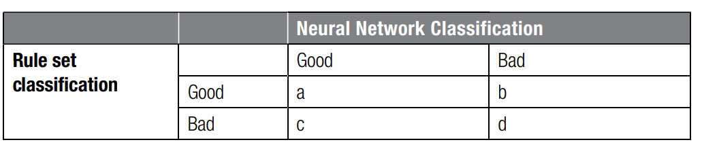

Fidelity is calculated using a confusion matrix, which summarizes the performance of a classification model.
 |  | PREDICTED
ACTUAL |  | True | False
 | True | TP | FN
 | False | FP | TN

Slide 88
Two‐stage model setup
The two-stage model setup you described is a hybrid approach that aims to balance interpretability with performance in machine learning.
In this approach, you use two different models sequentially:
First Stage - Interpretable Model: Start with a simple, interpretable model such as linear regression or logistic regression. These models are easy to understand and interpret because their predictions are based on straightforward mathematical relationships.
Second Stage - Neural Network: Use a neural network to predict the residual errors (or errors) from the first model. This stage captures complex patterns and interactions that the simple model might miss, improving overall predictive performance.

Slide 89
How It Works
Train the Interpretable Model:Train a linear regression or logistic regression model on your data. This model provides predictions and a clear understanding of how each feature contributes to the target variable. For example, in a linear regression model, you can see the coefficient of each feature, which directly shows its influence on the target.
Calculate Residuals:Compute the residuals, which are the differences between the actual values and the predictions made by the interpretable model.
Train the Neural Network: Use the residuals from the first model as the target variable to train the neural network. The neural network learns to predict these residuals using the same features.
Combine Both Models:Combine the predictions of the linear model and the neural network to get the final prediction. For regression, the final prediction might be:
For classification, the final prediction might be:

Slide 90
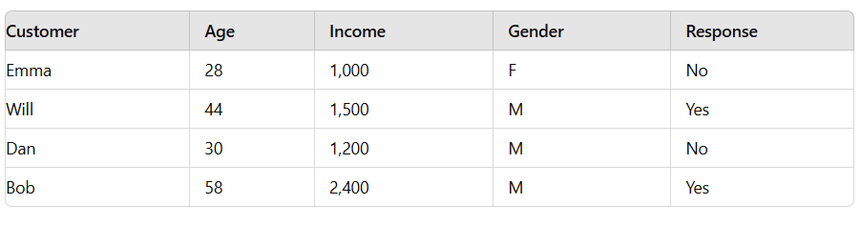
Two stage Models Illustration - Procedure
Step 1: Start from original data.
Step 2: Build logistic regression model.
Step 3: Calculate errors from logistic regression model.
Step 4: Build NN predicting errors from logistic regression model.
Step 5: Score new observations by adding up logistic regression and NN scores.

Slide 91
Two stage Models Illustration
Step 1: Original Data
Step 2: Logistic Regression Model

Slide 92
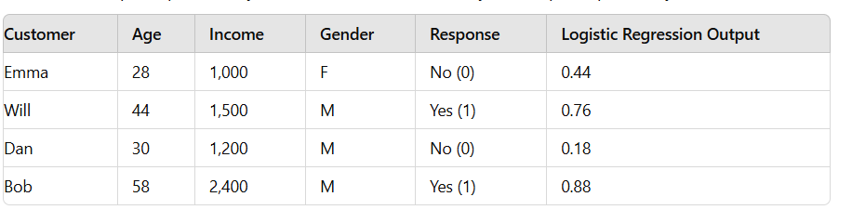
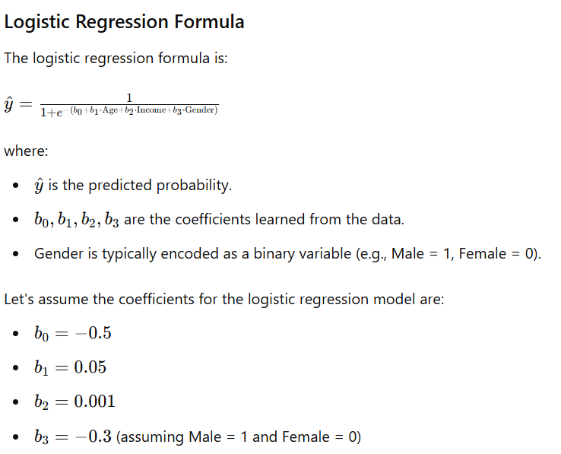
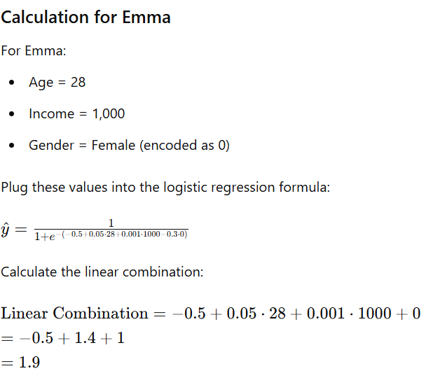
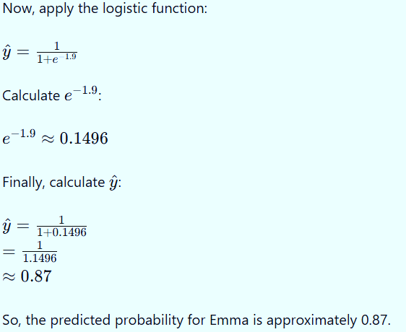

Slide 93
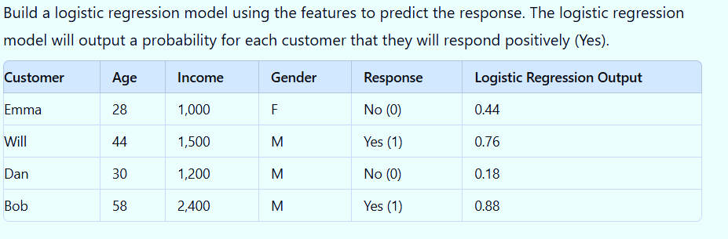

Slide 94
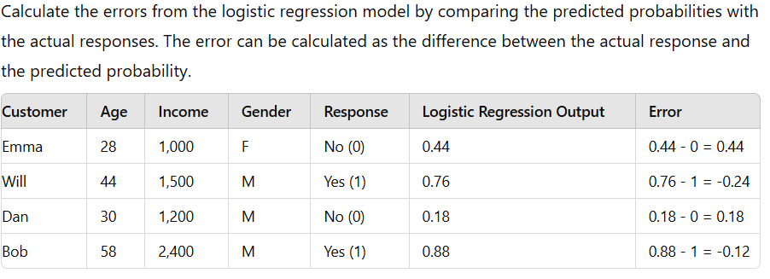
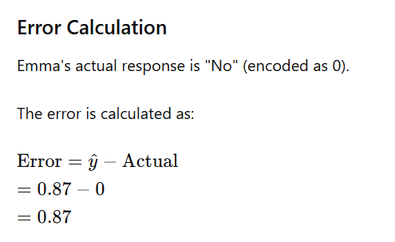
Step 3: Calculate Errors

Slide 95
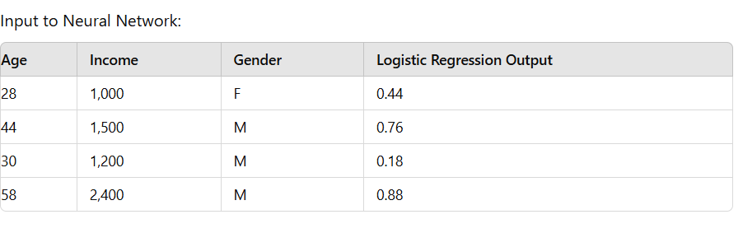
Step 4: Neural Network Model
Use the logistic regression output along with the original features as input to the neural network. The neural network will further refine the prediction.

Slide 96
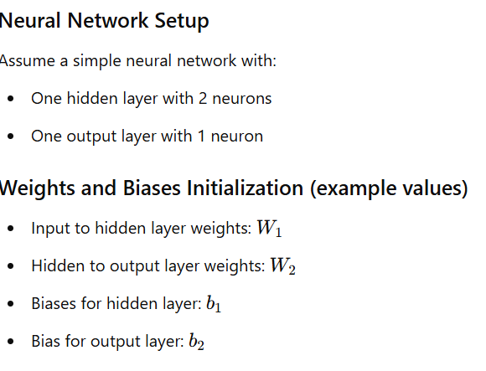
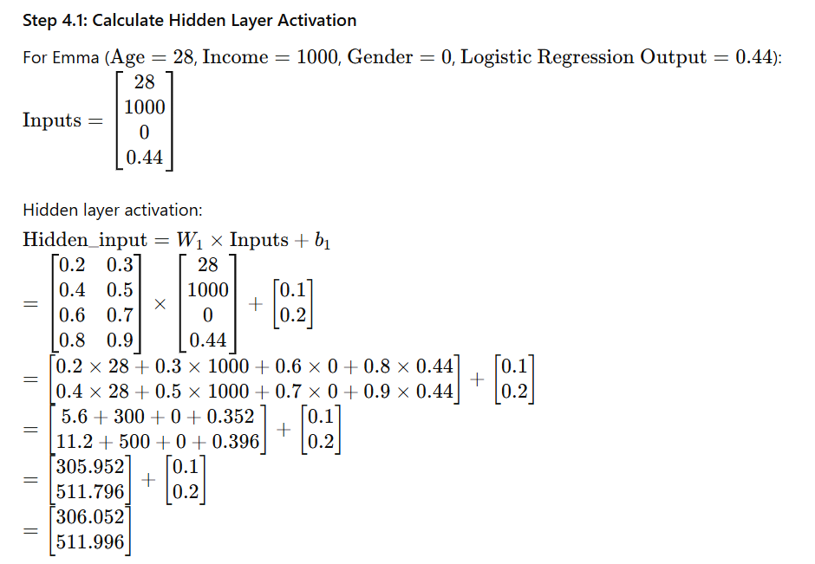
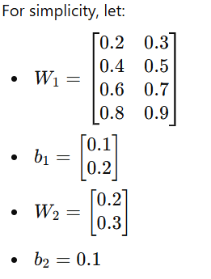
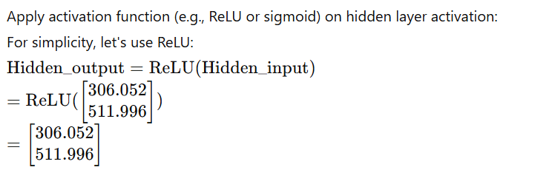
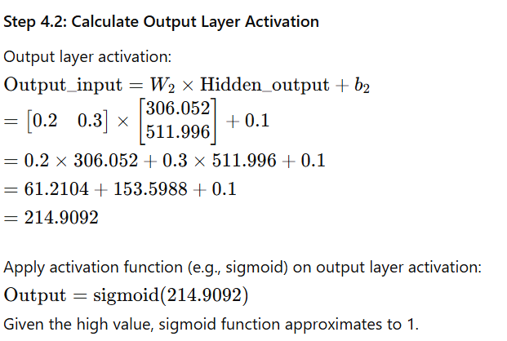

Slide 97
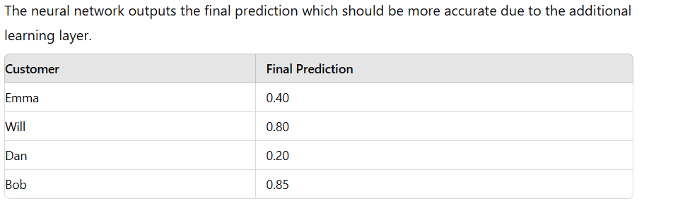
Step 5: Final Prediction

Slide 98

Two key shortcomings of neural networks
1. Function is non convex(may have multiple local minima)
2. Tune the number of hidden neurons.
Support Vector Machines will solve these outcomes.
It is a supervised machine learning algorithm that classifies data by finding an optimal line or hyperplane that maximizes the distance between each class in an N-dimensional space.
The objective is to classify instances (e.g., customers) into two categories (e.g., good and bad) by minimizing the sum of error variables.

Slide 99


The classification task involves two sets of constraints, one for good customers and one for bad customers.
The constraints aim to assign scores based on a linear combination of features, using weights w1,w2,w3………….wn.
For Good Customers (1 ≤ i ≤ ng​)
For each good customer, the score should be above a certain cut-off value c, minus an error term ei:
For Bad Customers (ng+1 ≤ I ≤ ng+nb​)
For each bad customer, the score should be below the cut-off value c, plus an error term ei:
The error terms ei are non-negative:
ei≥0

Slide 100

SVM Classifier for the Perfectly Linearly Separable Case

